Slide 1
FlyClient
Super-Light Clients for Cryptocurrencies
Mahdi Zamani, Loi Luu, Benedikt Bunz
Visa Research
March 2018

Slide 2
Blockchain Payment Verification

Slide 3
Blockchain Size: A Growing Problem
How am I going to store 150 GB?

Slide 4
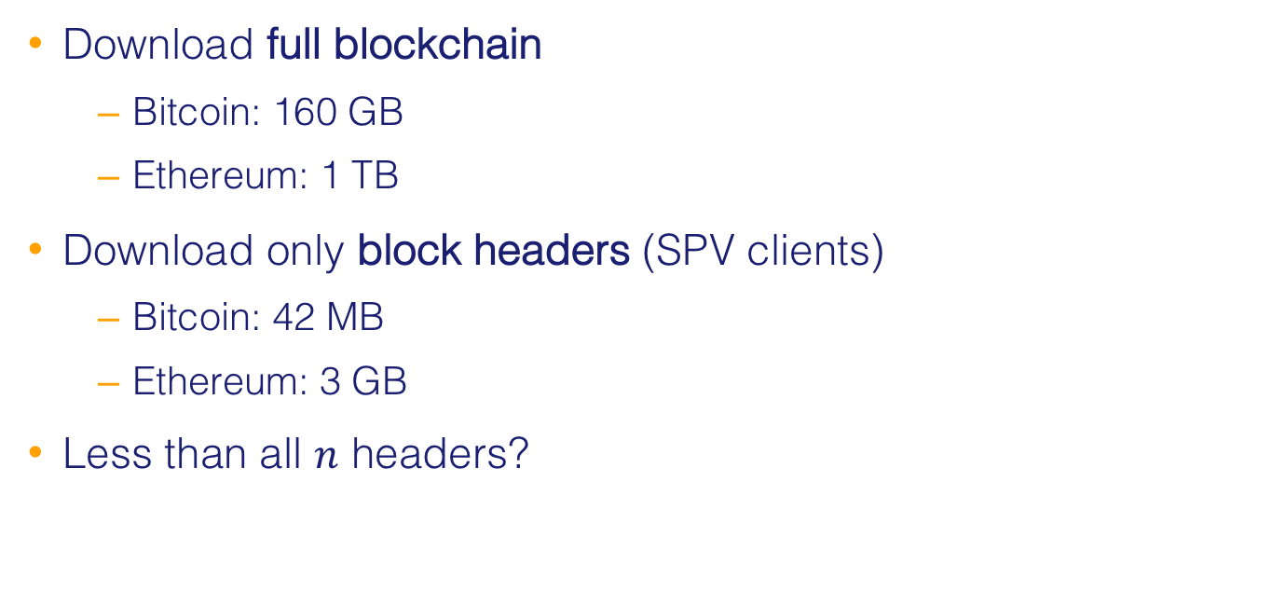
Payment Verification in Cryptocurrencies
Download full blockchain
Bitcoin: 160 GB
Ethereum: 1 TB
Download only block headers (SPV clients)
Bitcoin: 42 MB
Ethereum: 3 GB
Less than all $n$ headers?

Slide 5
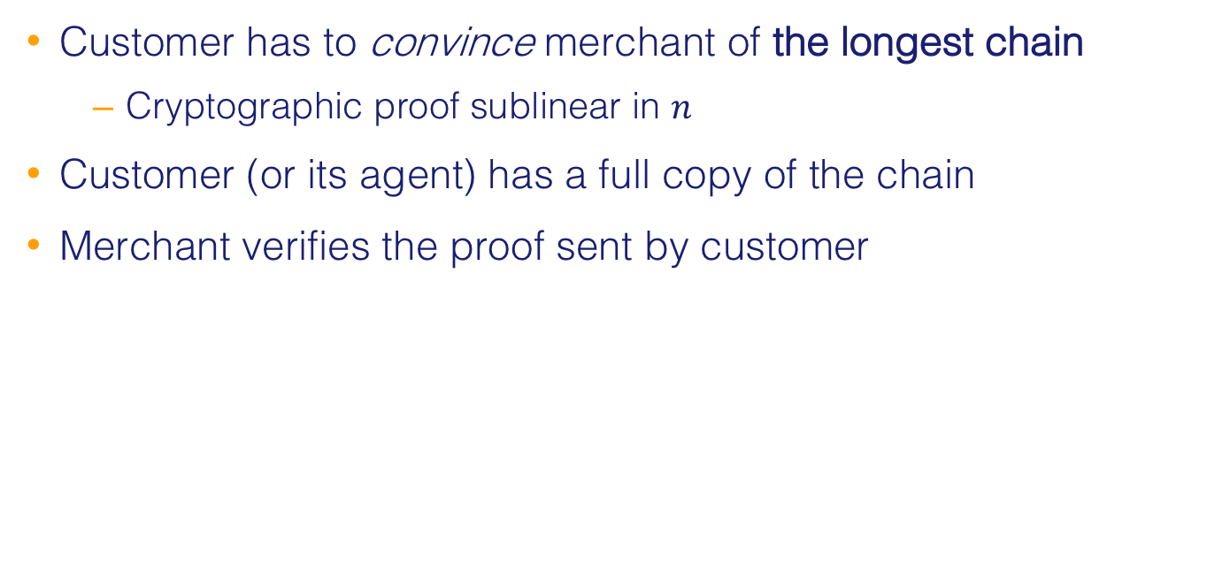
Main Challenge
Customer has to convince merchant of the longest chain
Cryptographic proof sublinear in $n$
Customer (or its agent) has a full copy of the chain
Merchant verifies the proof sent by customer

Slide 6
Bitcoin Block Structure

Slide 7
Bitcoin Blockchain Format
prev: H( )
prev: H( )
prev: H( )
trans: H( )
trans: H( )
trans: H( )
H( ) H( )
H( ) H( )
H( ) H( )
Merkle Tree
transaction
transaction
transaction
transaction

Slide 8
Bitcoin Block Header
Field Name | Bytes
Version | 4
Previous block header hash | 32
Merkle root hash | 32
Timestamp | 4
nBits (mining difficulty) | 4
Nonce | 4
Total | 80

Slide 9
Ethereum Block Header
Field Name | Bytes
Parent hash | 32
Ommers hash | 32
Beneficiary | 20
State root | 32
Transaction root | 32
Recipient root | 32
Logs bloom | 256
Difficulty | 4*
Number | 4*
Gas limit | 4*
Gas used | 4*
Time stamp | 4*
Extra data | 32
Mix hash | 32
Nonce | 8
Total | 528
*System dependent (minimum considered)

Slide 10
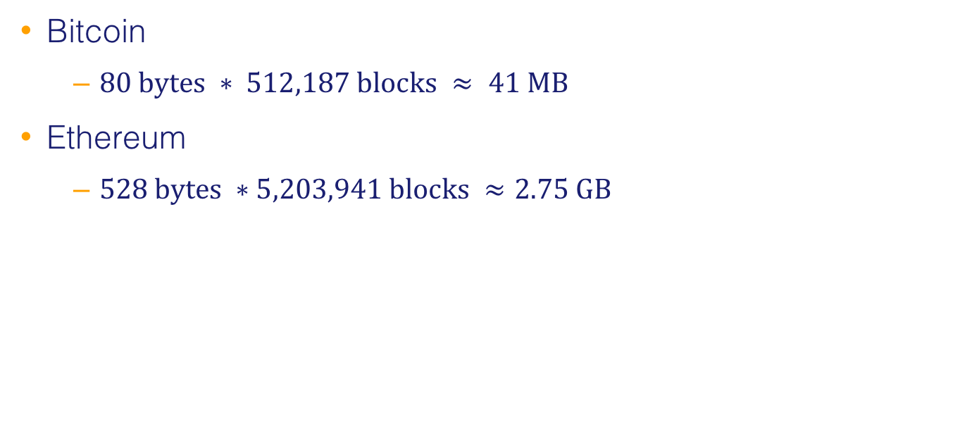
Header Chain Sizes of March 5, 2018
Bitcoin
$80 bytes ∗ 512,187 blocks ≈ 41 MB$
Ethereum
$528 bytes ∗5,203,941 blocks ≈2.75 GB$

Slide 11
Simple Payment Verification (SPV) [Nakamoto ‘08]
prev: H( )
prev: H( )
prev: H( )
trans: H( )
trans: H( )
trans: H( )
H( ) H( )
Idea:
Only store block headers
H( ) H( )
H( ) H( )
transaction
transaction
transaction
transaction

Slide 12
System Model
Prover (full node)
Verifier (light client)

Slide 13
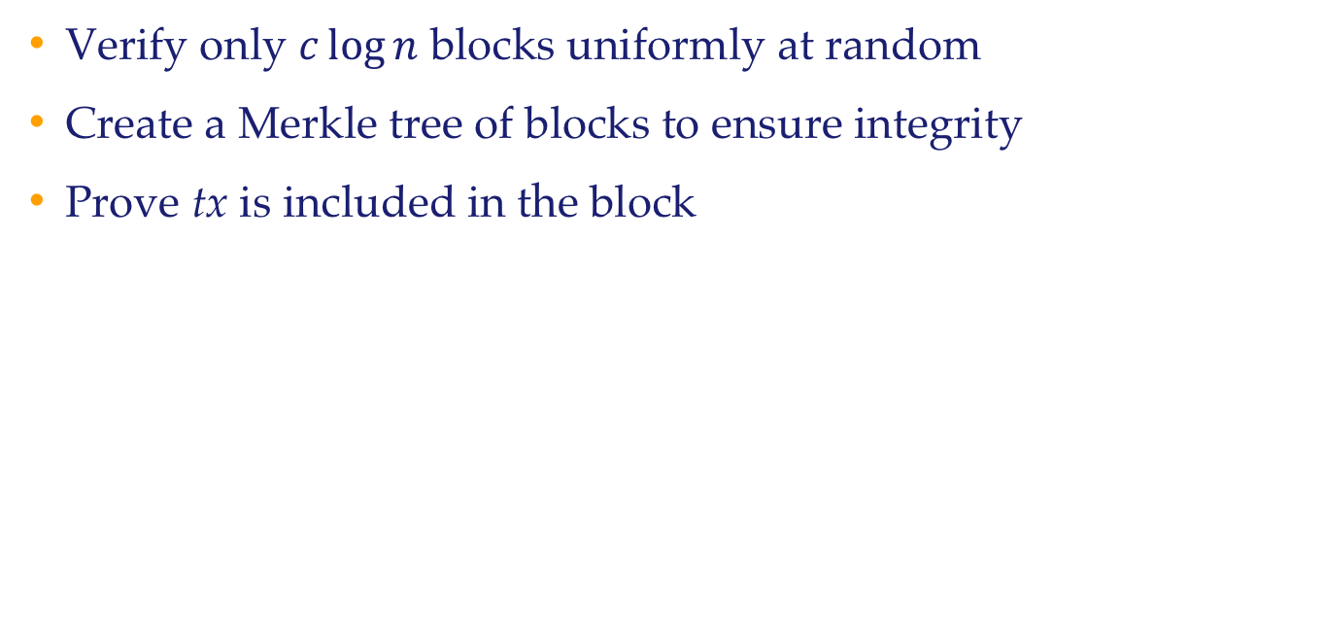
FlyClient Overview
Verify only $c\log{n}$ blocks uniformly at random
Create a Merkle tree of blocks to ensure integrity
Prove tx is included in the block

Slide 14
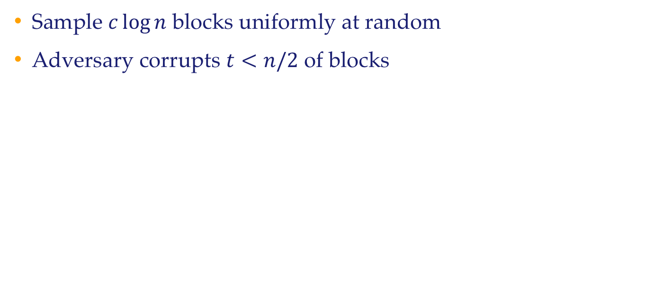
Probabilistic Block Sampling
Sample $c\log{n}$ blocks uniformly at random
Adversary corrupts $t<n/2$ of blocks

Slide 15
Block Inclusion Verification
Ensure sampled blocks belong to the same chain
Otherwise, malicious prover can send fake blocks
Blocks that are correctly-mined but refer to wrong prev. blocks
Strawman: Use a Merkle tree
Ensures a given block is at a certain position

Slide 16
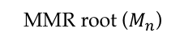
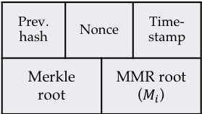
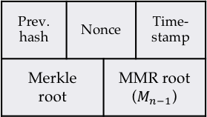
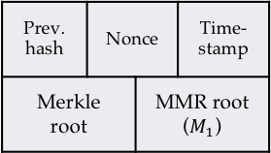
Merkle Mountain Range
MMR root ($M_{n}$)
Mountain Merkle Range
(MMR)
Prev. hash | Nonce |  | Time- stamp
Merkle root |  | MMR root ($M_{1}$)
…
Prev. hash | Nonce |  | Time- stamp
Merkle root |  | MMR root ($M_{i}$)
…
Prev. hash | Nonce |  | Time- stamp
Merkle root |  | MMR root ($M_{n−1}$)
Block headers →
Chain head
TX Merkle Tree
TX Merkle Tree
TX Merkle Tree
tx

Slide 17
Finding the Forking Point

Slide 18
Proof of State in Ethereum
Contracts can generate new transactions
User generated tx is stored in blockchain
Contract transactions are stored in the state
Digital asset holdings, name registrations, the status of financial contracts, etc.

Slide 19
Ethereum Block Structure

Slide 20
Implementation
Changed Ethereum’s client code (go-ethereum)
Checksum tree (Merkle mountain range) written in Go
Prover and verifier modules written in Python
Non-interactive protocol

Slide 21
Checksum Tree

Slide 22
Block Modification

Slide 23
Test
Parameters
Chain length: 6 million blocks
Adversarial power: 33%
Failure probability: 2⁻¹³⁰
Result
Proof length: 470 KB (~99.97% bandwidth & storage reduction)

